Slide 1



Internet Innovation…..
The Future of Africa
Dr. Bello Moussa
Director Innovations & Industries Relations
Huawei Technologies South Africa
Notes:
No one will denie how The Internet has become so vital, in our lives. Its continuously evolving and has developed into a an integral part of it…

Slide 2

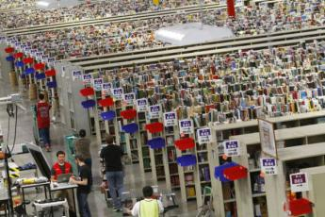

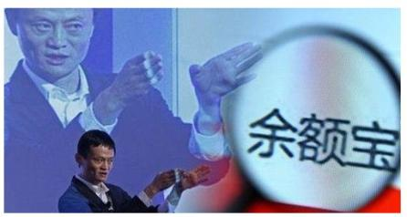
Disruptive Change is Happening…
OTT ( Alibaba..) Disrupts Bank Services
Google Glass Enters the Operating Room
Amazon Retail Business & “Distribution Centre”
He has no engine
He does not need refueling……
Tesla & “Connected Cars”
Internet will bring huge innovations and enable limitless possibilities
Next 20 years will see emergence of a profound synergy between digital and physical worlds
Notes:
The internet is changing the way we live, work, produce and consume.
The internet is reshaping public and private sector structures, creating new markets new opportunities and obviously new challenges for business
With such extensive reach, digital technologies cannot help but disrupt many of our existing models of business and government.
As we enter the age of the Fourth Industrial Revolution, a technological transformation driven by the internet, the challenge is to manage this seismic change in a way that promotes the long-term health and stability of the internet.

Slide 3
Connection is extending from things to Production Processes
8 billion
mobile connections
in 2014
100 billion
things
connected
in 2025
47 million new sensors connected per day
Internet of People
Internet of Things & Service
Notes:
Few years ago , Personal Connectivity is the only very visible sign of how the internet is being used.
The increasing availability of always-on connectivity and real-time services made possible through affordable ubiquitous broadband is transforming the way we live. Passive input from post processing of data is shifting to proactive and predictive data analytics designed to complement, or even digitally drive our physical lives. What impacts the way we experience each and every day is moving outside of traditional spheres of influence and into new and exciting realms of inspiration

Slide 4
Entering into the Shift Age…from Consumer
Internet to Industrial Internet…
Industrial Internet
Consumer Internet
Industry Leader Dominate?
OTT Dominated
Industrial Internet Evolution Roadmap
Market Size (trillion $)
Media
Retail
Finance
Education
Medical
Traffic
Government
Manufacture
Agriculture
Energy
Source: OECD, S&P, Huawei MI
Notes:
gradually moving from consumer internet to industrial Internet or 4th Industrial Revolution and Internet is driving this revolution: and this is the innovation of the Internet or on the Internet…. And no industry will be spared from it….
The internet is the central « life support system “ for the fourth industrial revolution
Arguably the biggest driver of productivity and growth in the next decade, this latest wave of digital innovation will accelerate
the reinvention of sectors that account for almost two-thirds of world output.1
There is a difference, however, between the availability of these technologies and capitalizing on their full potential
by applying them effectively within organizations, through entire supply chains and across multiple industries

Slide 5

Integration of the Internet to Industries is catalytic
for the Economy
Platform: Digitization
Internetization
New Growth Paradigm
Bolstered by tech, but triggered by [Internet + Verticals]
Agriculture
Smart Grid
Internet PR %
OTT Eco
Maturity
e-Commerce
&Retail
Health
GDP
Growth Rate %
Smart Home
Smart City
Innovation
Index
State
Index
Banking
&Finance
Verticals
+ Internet
Education
ICT
Index
CDN/IDC
Cloud
Big Data
e-Government
e-Enterprise
Productivity
Increase %
Employment
Rate
Industry&
Manufacturing
Restaurant
&Travel
Mobile PR%
BB PR %
Bandwidth
Entertainment
Transportation
Source: Huawei Consulting Analysis
Source: Huawei Consulting Analysis
Notes:
Result of integration of digitized tech is Internetization
Technology supports internetization, internetization creates new measurable growth
.

Slide 6








Internet Innovation: Enabling the New
Industrial Revolution
Energy
Singapore Smart Nation
Digital Canada 150
Smart Digital Malaysia
Medicine
Traffic
Economy
Commerce
Industry 4.0
Advanced Manufacturing 2.0
Internet Plus
Education
Work
People-Centric
Nigeria National
Broadband Strategy
Colombia Live Digital
Connected Argentina
Productivity
140 countries have developed national broadband plan strategy or policy - ITU
Smart Home
Security
Source: Analysys Mason research
Notes:
The internet Innovation will be the possibility of Connectivity through network and sensors linking machine devices connecting people, Homes transports, manufacturing and logistics enabling is to optimize assets mange supply chains and improve quality of life.

Slide 7














Industry 4.0 – the German vision for advanced manufacturing
Horizontal connection with vertical Business
Car
To X
Smart
City
Smart
Life
Smart
Traffic
Market
Dynamic
Requirements
Market
Satisfied
customers
Smart
Service
IoT World
Smart Factory
Product Design
Modeling & Simulation
Production Planning
Digital Engineering
Virtual/Physical
Real Time Sync
Production
Engineering
Production
execution
(Integration Practices)
Virtual Manufacturing
Real production
Notes:
industry 4.0 was first introduced by the German government as a hightech strategy to promote the computerisation of its manufacturing industry

Slide 8












The Industrial Internet is the foundation of Industry 4.0
IoT
Smart Grid
Customer
Supplier
Other IoT Eco partner
Cloud
Datacenter
Smart Factory
ERP
PLM
MES
IT infrastructure
Business
& Design
CRM
Agile Network
SCADA
Enterprise Network
IoT Gateway
Industrial Network
Automation & Controller
Smart
Production
Lite OS
Workflow
Machine
Robot
Sensor
Network
Control-system
IT platform (Software)
Workflow
IOT platform
Notes:
CORE, blue print of german industry 4.0

Slide 9
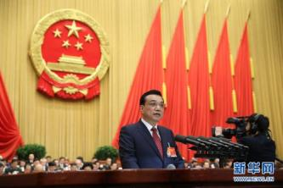








China: From Broadband 2020 to Internet +
Definition of Internet+
Phenomenon of Internet+
Essence of internet+
+
=
Internet
Market
Financial
&logistics
+
+
=
Cloud&
Network&Terminal
Internet
Marketing
&Sale
Procurement
&product
Store
+
Internet
+
+
=
+
Internet
Li Keqiang: “ Promoting Mobile Internet， Cloud Computing， Big Data and Internet of Things to combine with modern manufacturing industry， and boosting the development of Electronic Commerce， Industrial Internet and Internet Finance”
Bank
+
=
Internet
Taxi
With help of Internet to make Information more equivalent, leading to enterprise and industrial innovation
+
Internet
=
…
…
Notes:
Internet Plus was proposed by China premier
it refers to the application of the internet and other info technology in conventionl industries. Its an imcomplete equation where various internets( Mobile internet, Cloud and data can be added to other field.)
Fostering new industries and Business developement/.

Slide 10
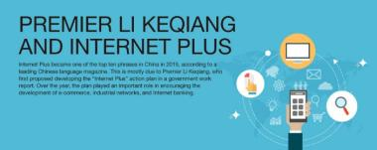
Internet+ Milestones
Achievement of Broadband China
2015.3
FTTH Penetration increase from 22pct to 56.1%.
Percentage of 8M+ broadband increase 29pct to 69.9% ,while 20M+ increase 23% pct to 33.4%.
2014.3 “Delivery Program of Broadband China 2014” was released by Dept of China Communication Industry, which include Broadband China Demo Rural Areas, and Broadband China Demo Cities.
.
2015
2015.3 “Broadband Map of China” was built by “China Broadband Alliance”.
2015.4 “China Broadband Access Network Opening Policy” was released.
2014
2012.3 “Guidance opinions on Broadband speed upgrade” was released by China Development Committee, Dept of China Communication Industry, etc. together.
2013
2012
2013.3 “China Broadband Alliance” was officially founded which sponsored by Dept of China Communication Industry, and the main members are Government, Carriers, OTT & ICT Industry Vendors etc .
2013.4 “Broadband China Strategy and Executive Plan” was officially released by The State Council of China.
Notes:
这页主要讲华为在南非的发展历史和华为在南非的重大项目（右），建议讲解重点放在讲华为对南非社会的贡献上，比如服务80%的南非人民、帮助南非的Mobile和FTTH基础设施建设、Training Center、e-learning项目、Gauteng Broadband Link等。

Slide 11
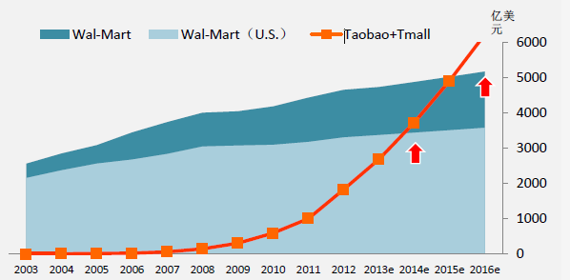





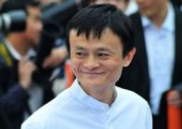




Socio –economic Effects of Internet+
Effect on retails : It Changed the retail, changed the life of Chinese people
Effects on financial industry: It Changed the
financial development
100M USD
+
250B
1850 M users
Cash
Card
Mobile
6.6B
2.5 M users
Increase 40% consumption
4 times efficient than traditional retail
Bank
ATM
Person Bank
User increase 740 times in 7 months
Capital increase 39 times in 7 months
27 M Parcels
8.5M Merchands
1000M goods
650MNetwok of users
100M Visits

Slide 12


Internet in Africa: Supply Vs Demand
Households with Internet Access (%)
People using the Internet (%)
Fixed BB Subscriptions (per 100 ppl)
Africa
Notes:
Africa is still lagging behind the developed world. There are still challenges around basic infrastructure to allow for the internet to flourish in the continent.

Slide 13




generation opportunity : Leapfrog Potential for Africa
5G
4.5G
100B
4G
30B
1ms
10ms
10Gbps
1Gbps
Deploy latest gigabit access
50ms
150Mbps
Massive IoT
Home
School
Connected Cars
2G
3G
AR/VR
Voice
Web
Video
Hospital
Tele-operation
High Speed Railway
Dial Up
ADSL
1 Gbps FTTH
10 Gbps FTTH
TWDM PON
Notes:
The good news is that Africa has a lot of potential, there is great development in what we call the ‘adopters stage’ of the Huawei Global Connectivity Index (GCI) that categorises countries from Starters, Adopters, and Front Runners,”

Slide 14
Huawei GCI
Benchmarking digital economy transformation
Traditional Economy
Digital Economy
The GCI provides a comprehensive and objective assessment of a country’s connectivity from both a national and business perspective.

Slide 15
Innovation within Technology Progression
Foundation Innovation
Internet Innovation
Data Innovation
Augmented Innovation
80K
Countries in this stage are still building their foundation.
Countries in this stage have already invested in connectivity technology and are looking to drive cloud adoption.
These nations represent the current GCI leadership. Focus continues to be on big data and the drive towards IoT adoption.
No country has yet reached this stage. big data maturity incorporated into smart IoT
IoT-centric
Nominal GDP pec Capita
Big Data-centric
Cloud -centric
Datacenter-centric
Broadband-centric
0K
15
35
55
85
100
Notes:
The good news is that Africa has a lot of potential, there is great development in what we call the ‘adopters stage’ of the Huawei Global Connectivity Index (GCI) that categorises countries from Starters, Adopters, and Front Runners,”

Slide 16
Broadband is Africa#1 technology enabler
Priorities for investing in technologies
Starters
Adopters
Frontrunners
Broadband
Data center
Cloud
Big data
IoT

Slide 17
Internet Innovation is Collaborative Innovation
Policies institutions and incentives：
Policies set the direction of digital transformation, and form the legal basis for a nation to act.
Incentives set the speed and depth of change and institutions drive change, provide governance, and monitor progress.
Manpower and skills：
Skilled manpower is at the heart of digital transformation. Technical, management, policy, and planning skills are all needed.
IT literacy is crucial as it affects how digital content is consumed and adopted by people at large.
Digital ecosystem:
Governments need to take the lead in digitally transforming themselves, driving cross-industry collaboration, and building long-term partnerships with the private sector and the financial world to create a robust ICT ecosystem.
Notes:
Policies, institutions and incentives, Manpower and skills, and Digital ecosystem.
Investments in ICT, particularly to infrastructure, is a fundamental building block in internet innovation and connectivity in a country. Proper infrastructure will improve a country’s broadband coverage and internet usage. Investment in the ICT industry also means an investment in skill development and training..
With technology evolving at breakneck speed, regulatory frameworks often lag behind. The rules that govern the use of all forms of data on the internet need to be relevant and appropriate to the pace of technological change.
As the internet becomes more pervasive, so do the tensions between national interests and global inter-operability. The rules governing the cyberworld are being tested on a daily basis as governments and individuals raise concerns about data security and privacy. The innovative potential unleashed by digital technologies is also raising questions about rules and ethics, as well as societal benefits and costs

Slide 18

Notes:
“The most profound technologies are
those that disappear. They weave
themselves into the fabric of everyday
life until they are indistinguishable from
it.”1
-Mark Weiser, Chief Technologist at the
Xerox Palo Alto Research Center
(PARC), 1991

